Slide 1

Topics Covered
Overview
Proposed Application
User Analysis
Functional Requirements
Non-Functional Requirements
Context Model
User Interface
Pseudocode
Risk Assessment
Testing
Future Goals
Recording

Slide 2
Overview
The "Student Assist" app is like an all-in-one support system for students, covering everything from academics to personal well-being.
Secure Access: The app ensures your privacy with a secure login system. Whether you use your HawkID or email, the focus is on keeping your data safe.
Efficient Task Management: Stay on top of your tasks effortlessly. You can create, update, and track your tasks, noting details like names, priorities, related courses, due dates, and owners. The app even lets you lock completed tasks for better organization.
Academic Performance Tracking: Keep a detailed record of your academic journey. The app helps create course records, logging scores and calculating percentages automatically. It's all about promoting transparency in how you're doing academically.
Insightful Course Dashboard: Get a bird's eye view of your courses. The app generates a detailed report with course codes, names, and score logs. It's a handy tool for a data-driven approach to understand your academic progress.
Personalized Health Monitoring: The app processes health data, offering personalized recommendations. It keeps an eye on vital signs like heart rate, giving real-time advice and creating a seamless link between your health and overall well-being.

Slide 3

Proposed Application
The "Student Assist" app is structured with a focus on three key components: Task Management, Academic Progress Tracking, and Health Monitoring.
1. User Profile:
This section serves as the user's hub, displaying their academic journey, task management history, and health monitoring data. Users can create personalized profiles, manage settings, and access their overall progress.
2.Task Management:
Dedicated to enhancing task management, this page features an integrated platform for creating, updating, and tracking tasks. It includes personalized task plans, reminders, and a calendar synced with academic deadlines, ensuring users stay organized.
3. Academic Progress Dashboard:
Users can gain insights into their academic performance, course records, and percentage scores. The dashboard provides a comprehensive overview, fostering a data-driven approach to academic progress.

Slide 4
Proposed Application
4. Health Management(My Health):
The health monitoring section employs innovative features to assess and enhance students' overall well-being. It integrates health data, offers personalized recommendations, and establishes a seamless connection between health monitoring and overall student welfare.
5. User Engagement and Collaboration:
Promoting collaboration, this section includes features like study groups, discussion forums, and a community hub. Users can share insights, engage in academic discussions, and collaborate on projects, fostering a supportive online community.
6. Continuous Improvement Commitment:
The app is designed with a commitment to continuous improvement. User feedback is actively sought, and updates are regularly implemented to adapt to evolving user needs, ensuring the app remains a valuable and responsive tool for students.

Slide 5
User Analysis
Administrators:
These users play a crucial role in moderating chat rooms, assisting students and other app users with inquiries, acknowledging and acting on feedback, and editing and enhancing the system.
Students:
Students represent the primary target audience for the application. They actively engage with the app's features and provide valuable recommendations for its improvement.

Slide 6

Functional Requirements
Authentication and Registration
Supports login with username/password and Single Sign-On (SSO), offering flexible authentication options.
Registration involves creating profiles linked to IIT hawk email, ensuring a secure and personalized experience.
Task Management
Integrates with the blackboard calendar for setting academic goals, managing tasks, and receiving deadline reminders.
Allows users to add notes to tasks, aiding in effective time organization and priority setting.
Health Management
Activates during specific activities like studying, providing reminders for breaks and managing eye strain.
Enhances overall well-being by encouraging healthy habits during intense academic activities.
User Management
Includes comprehensive account management, password reset, and robust user authentication features.
Tracks user activity for audit purposes and enables feedback provision on services.

Slide 7
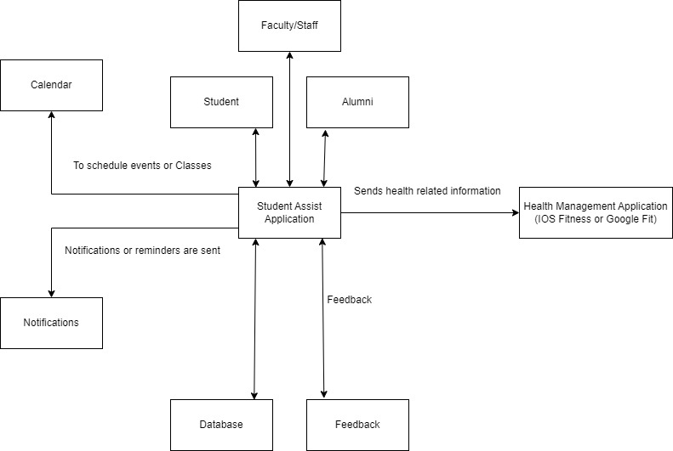
Context Model

Slide 8
Context Model
Database
Serves as a secure repository for user information, including academic records, preferences, and hobbies.
Implements robust data security measures to ensure user privacy and confidentiality.
Feedback Mechanism
Facilitates user engagement and participation for continuous improvement of the app.
Provides a vital channel for users to express their ideas, feedback, and concerns.
Calendar
Integrates with the student's calendar to manage class and event schedules.
Essential for organizing academic and personal commitments.
Notification Services
Delivers timely updates about deadlines, campus events, and important notices.
Balances effective communication with users without overwhelming them with information.
Health Management Application
Collaborates with third-party apps like IOS Fitness and Google Fit for health data collection.
Offers tailored health suggestions based on the collected data.

Slide 9
Non- Functional Requirements
Performance
Aims for high responsiveness, can be scaled-up for handling up to 20,000 users per hour with main page loading in under 4 seconds and actions within 1 second.
Ensures a smooth, speedy user experience even under heavy usage.
Scalability
Designed to maintain optimal performance and functionality, even with 1,000 concurrent users.
Focuses on system capability to handle increased loads without compromising quality.
Security
Implements Third Party Authentication to safeguard against unauthorized access and harmful software.
Ensures user data privacy by limiting access to personal information and adhering to strict security standards.

Slide 10
Non- Functional Requirements
Availability
Aims for a high availability rate, targeting the app to be operational and ready for users 98% of the time each month.
Prioritizes consistent system uptime and accessibility for users.
Reliability
Designed for a 90% reliability threshold, ensuring proper functionality for 90% of its usage time monthly.
Focuses on consistent performance and dependability of the system.
Maintainability
Commits to frequent updates and continuous bug fixes, with support for new features and functionalities.
Guarantees quick restoration, aiming for application recovery within 24 hours during maintenance periods.

Slide 11
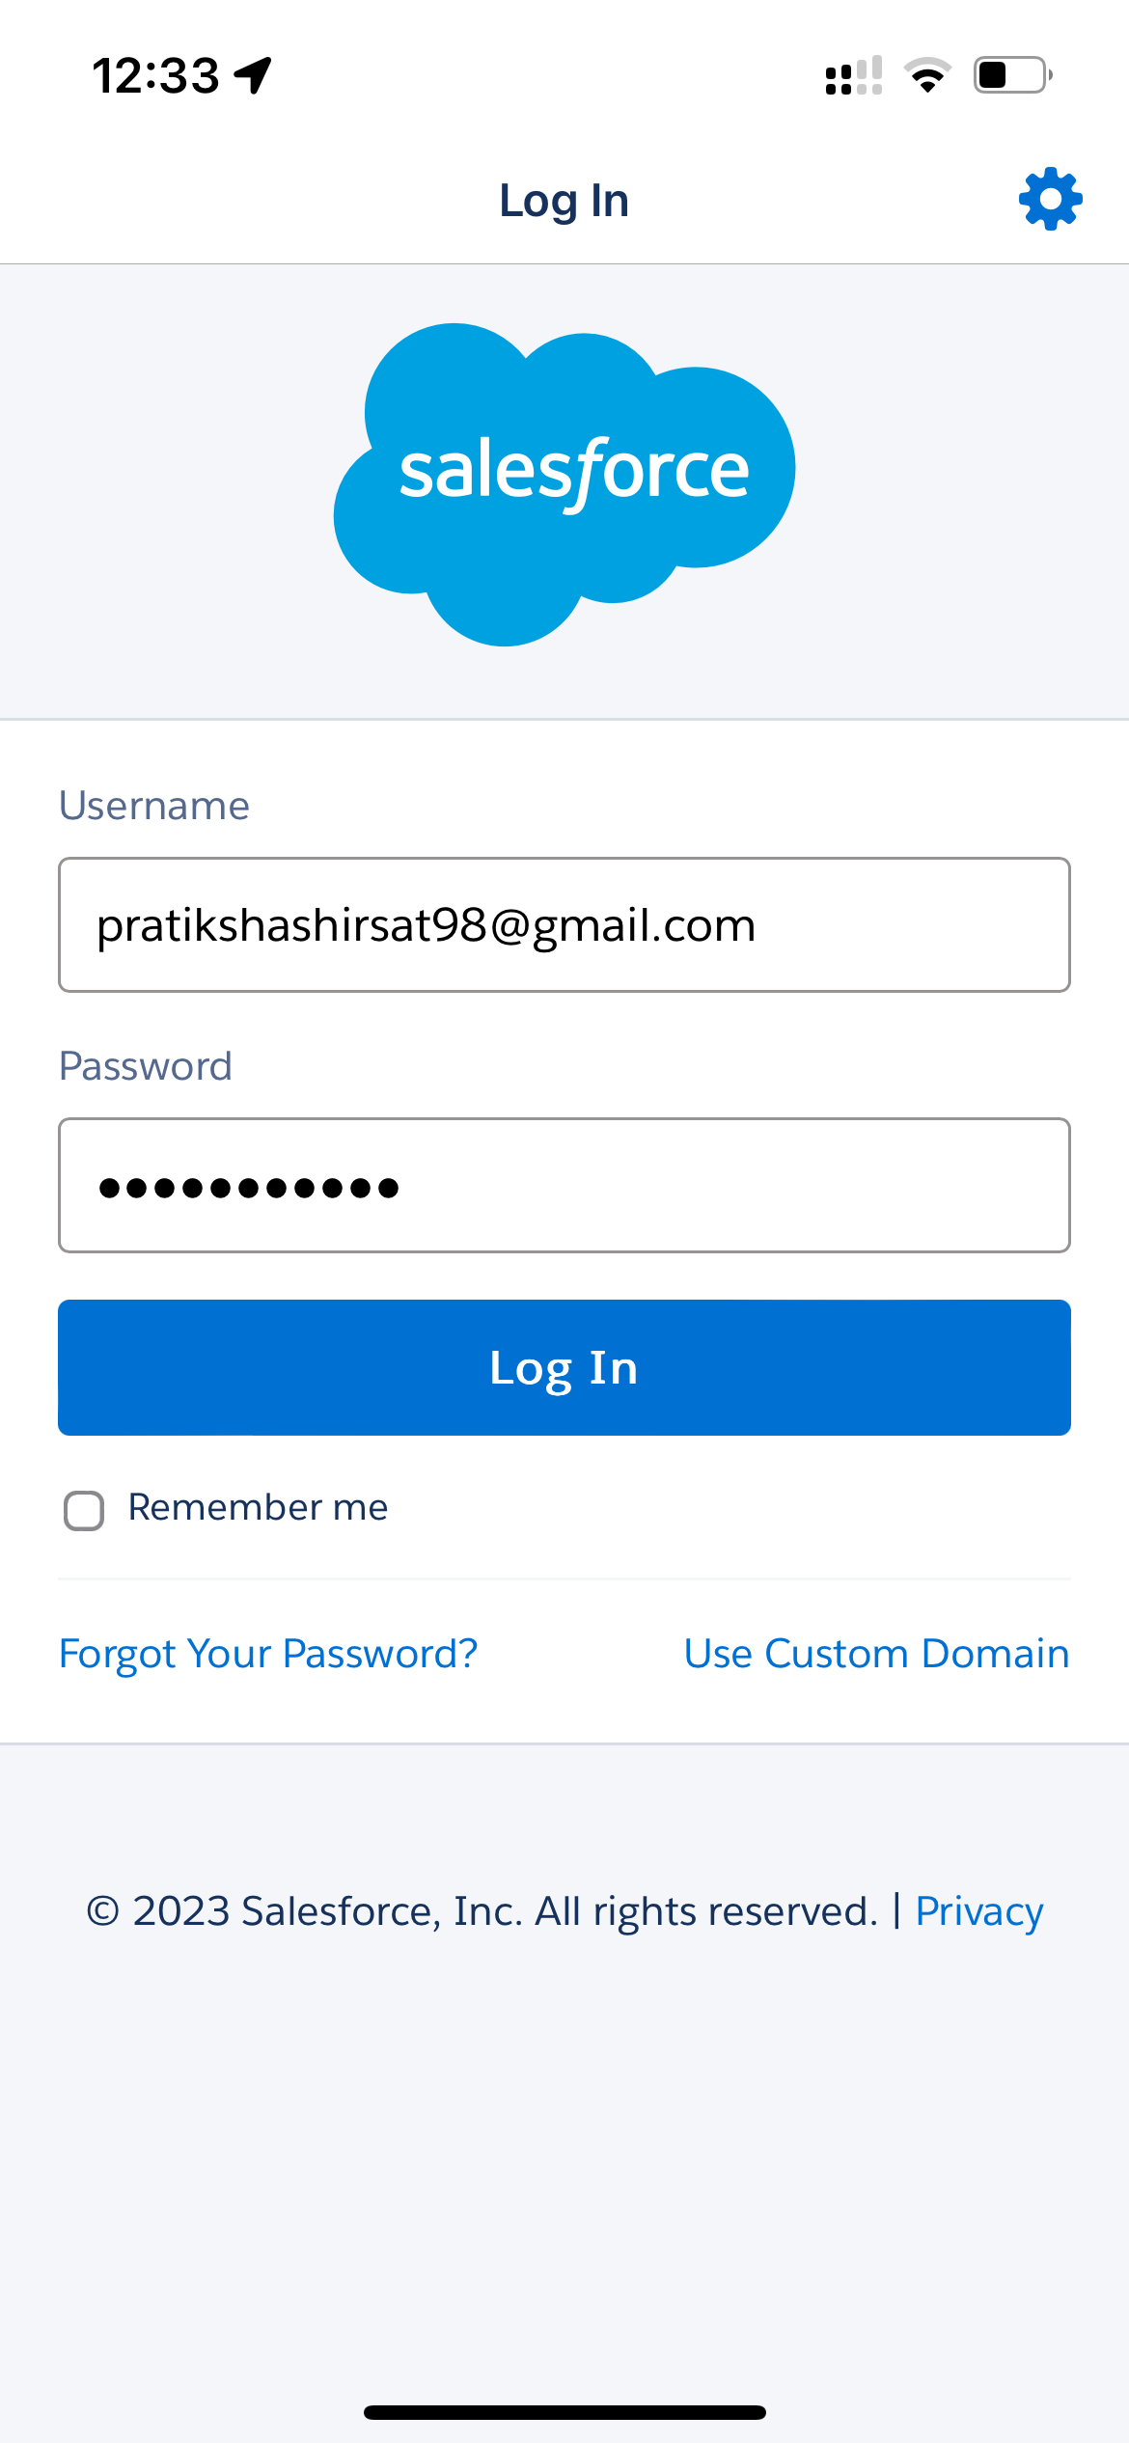
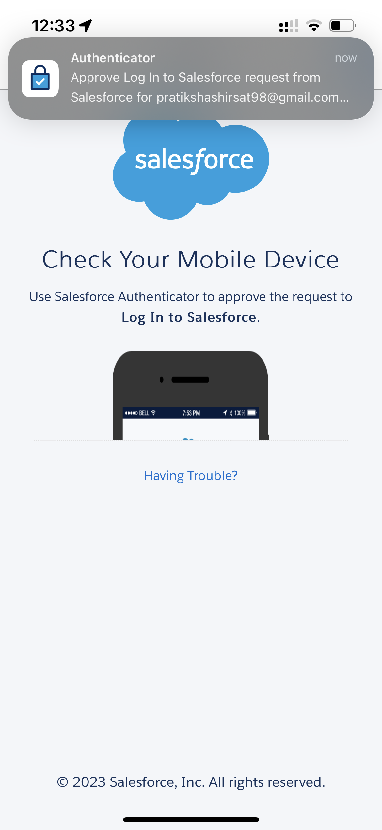
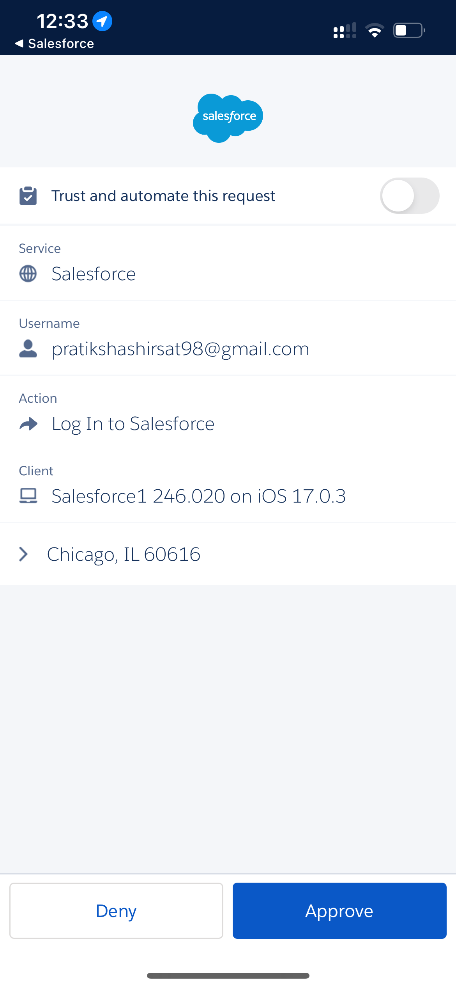
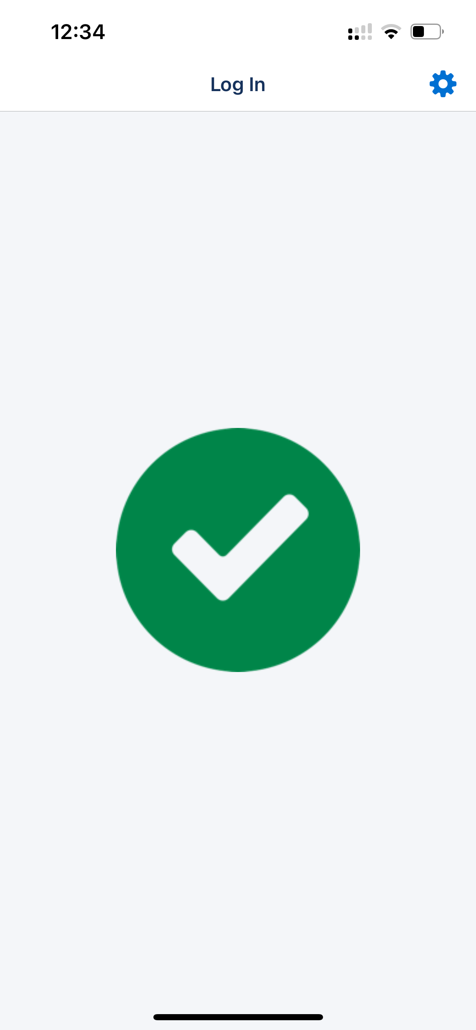
User Interface (Login Functionality)
User Login Page
Multi-factor Authentication
Approve or Deny Login Request
Approved

Slide 12
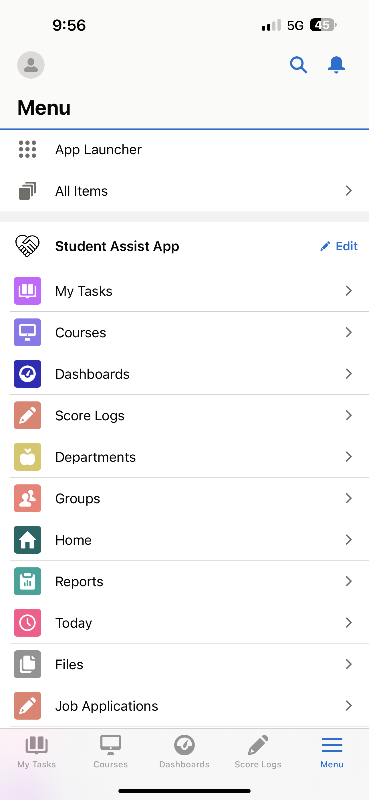
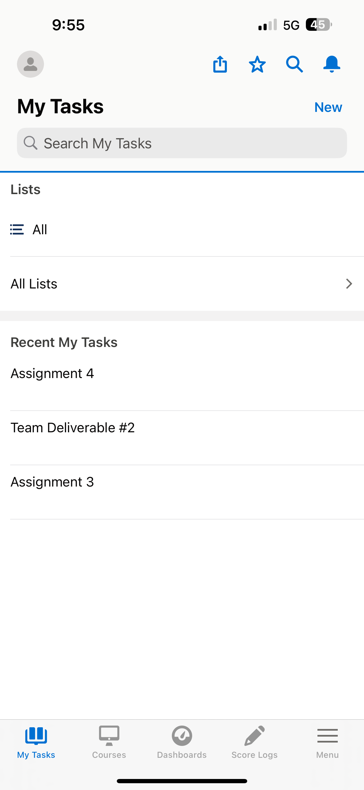
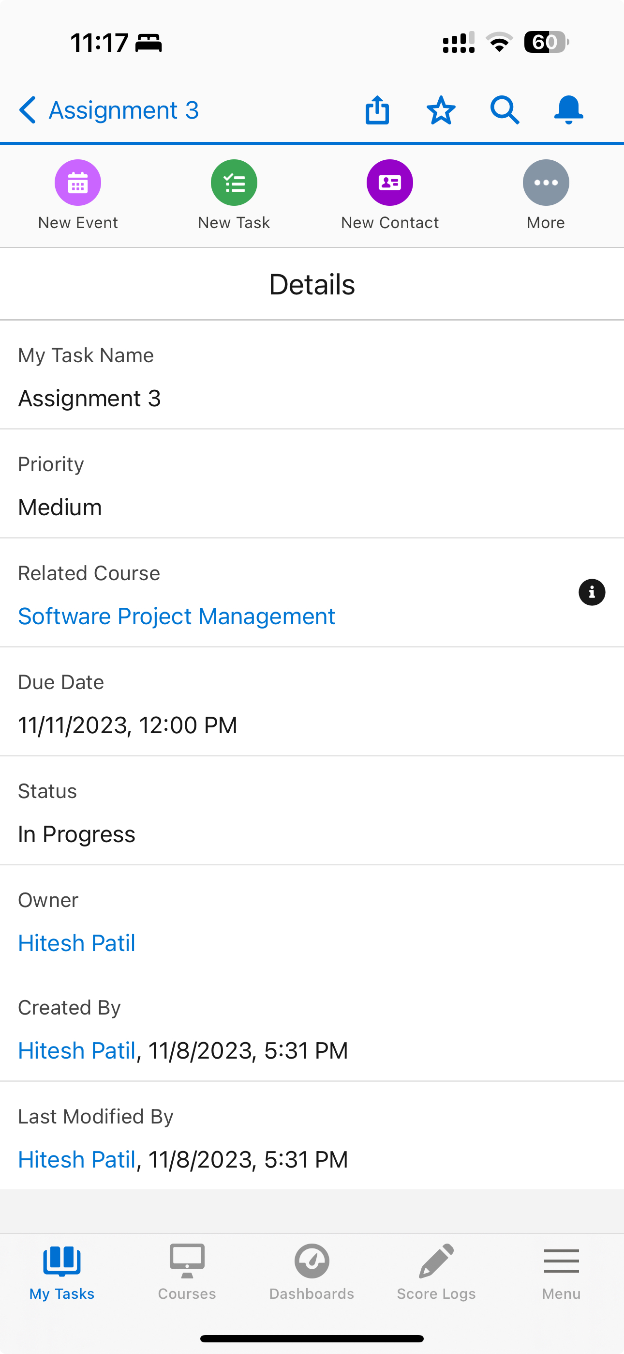
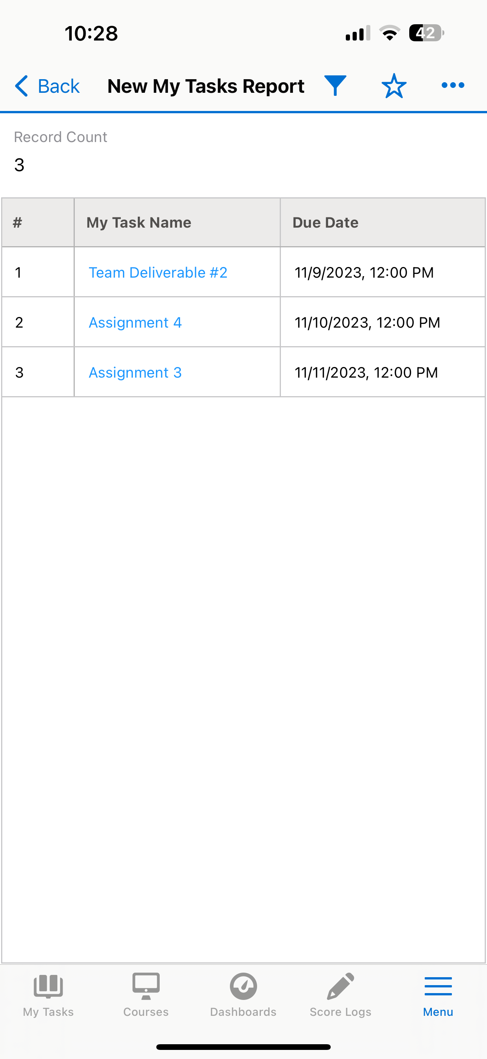
User Interface (Task Management)

Slide 13
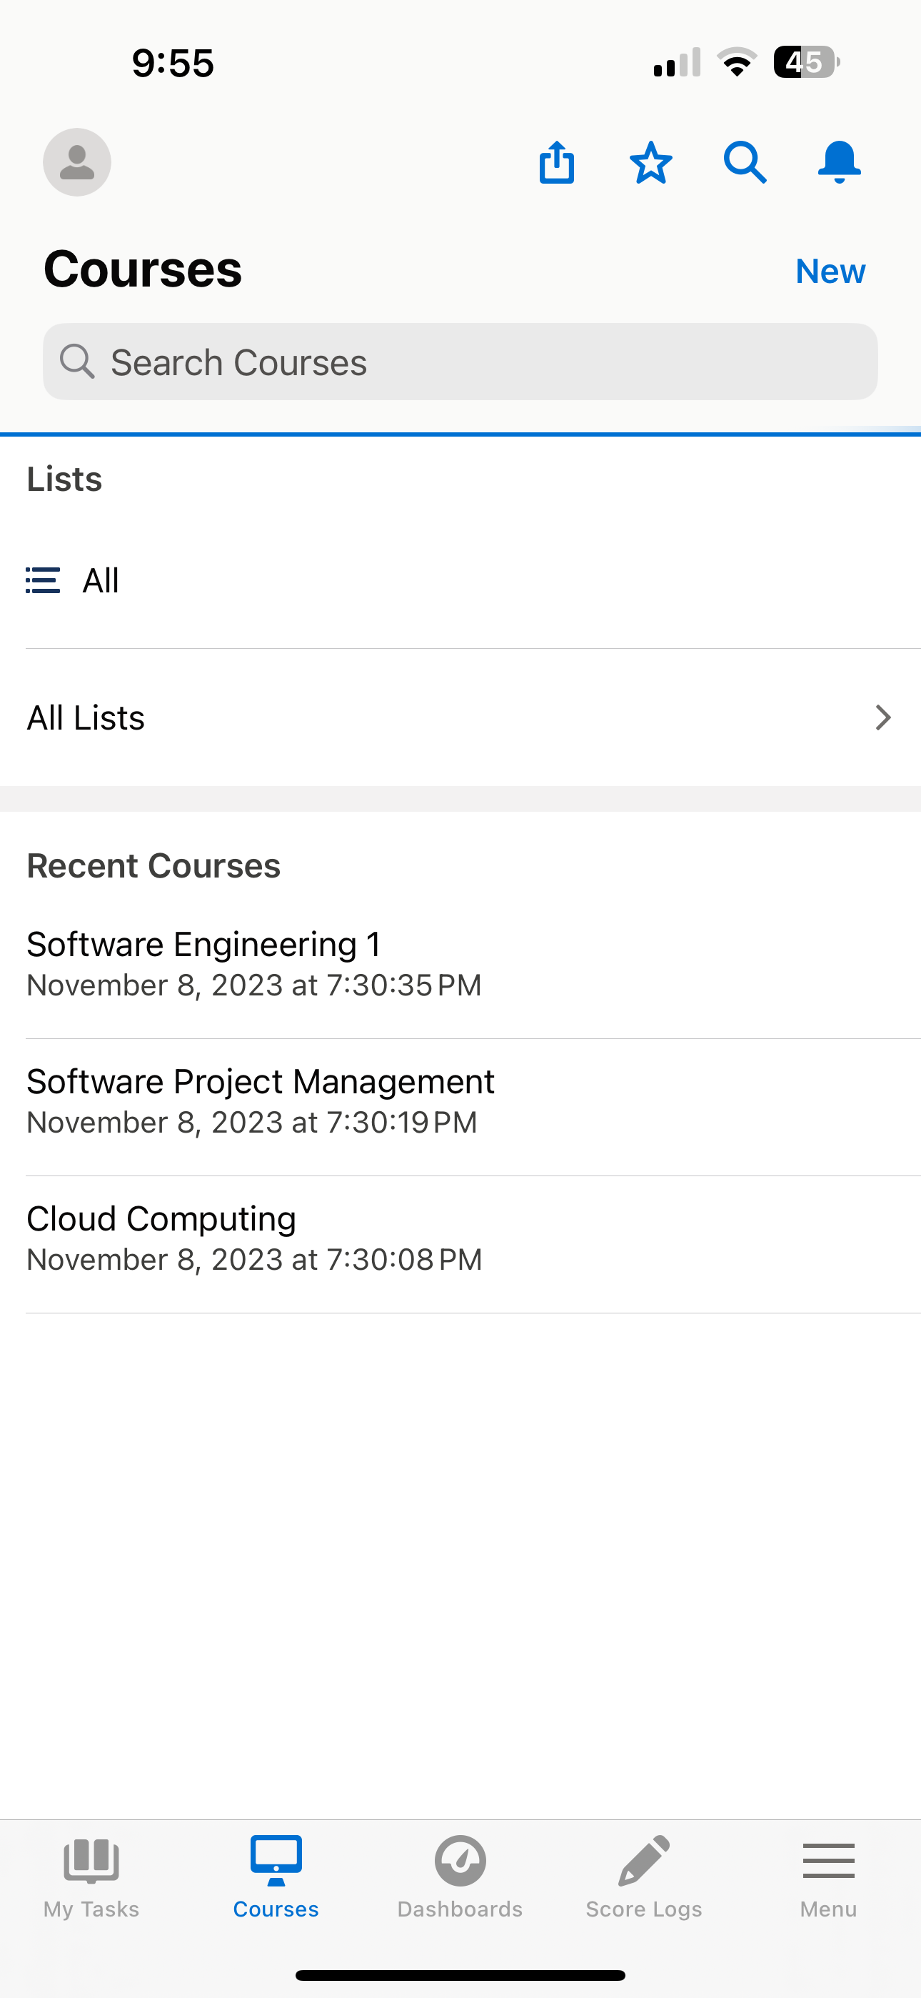
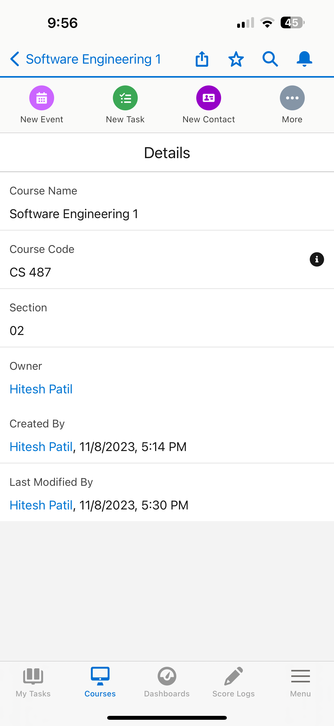
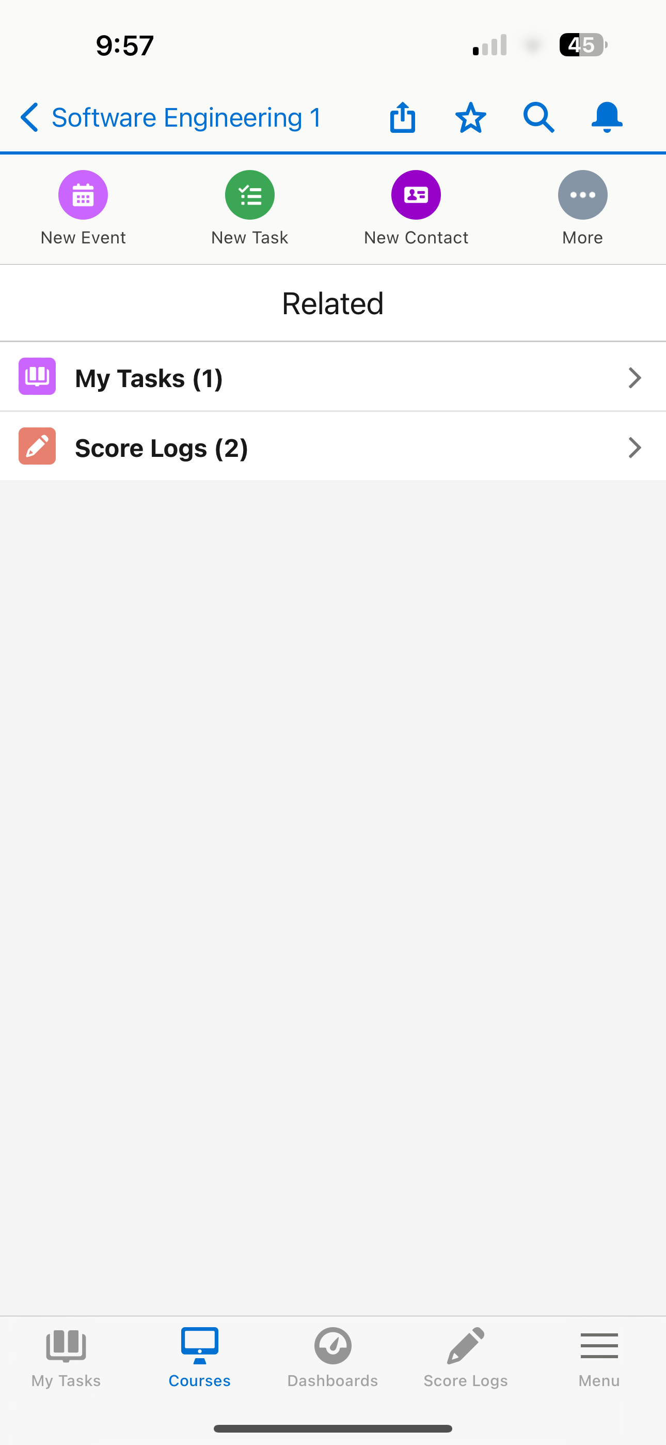
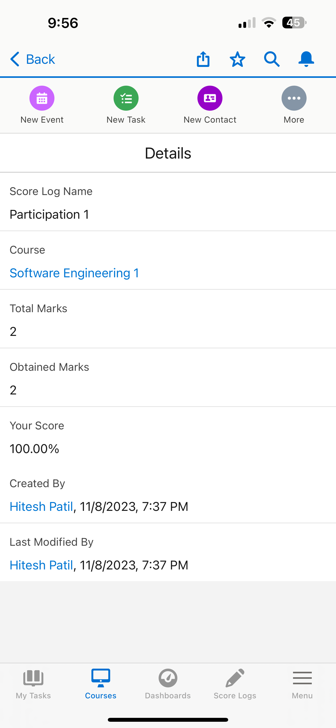
User Interface (Course Management)
Course Menu
Course details
Course Related Tasks/Scores
Score Log Related to
a particular course

Slide 14
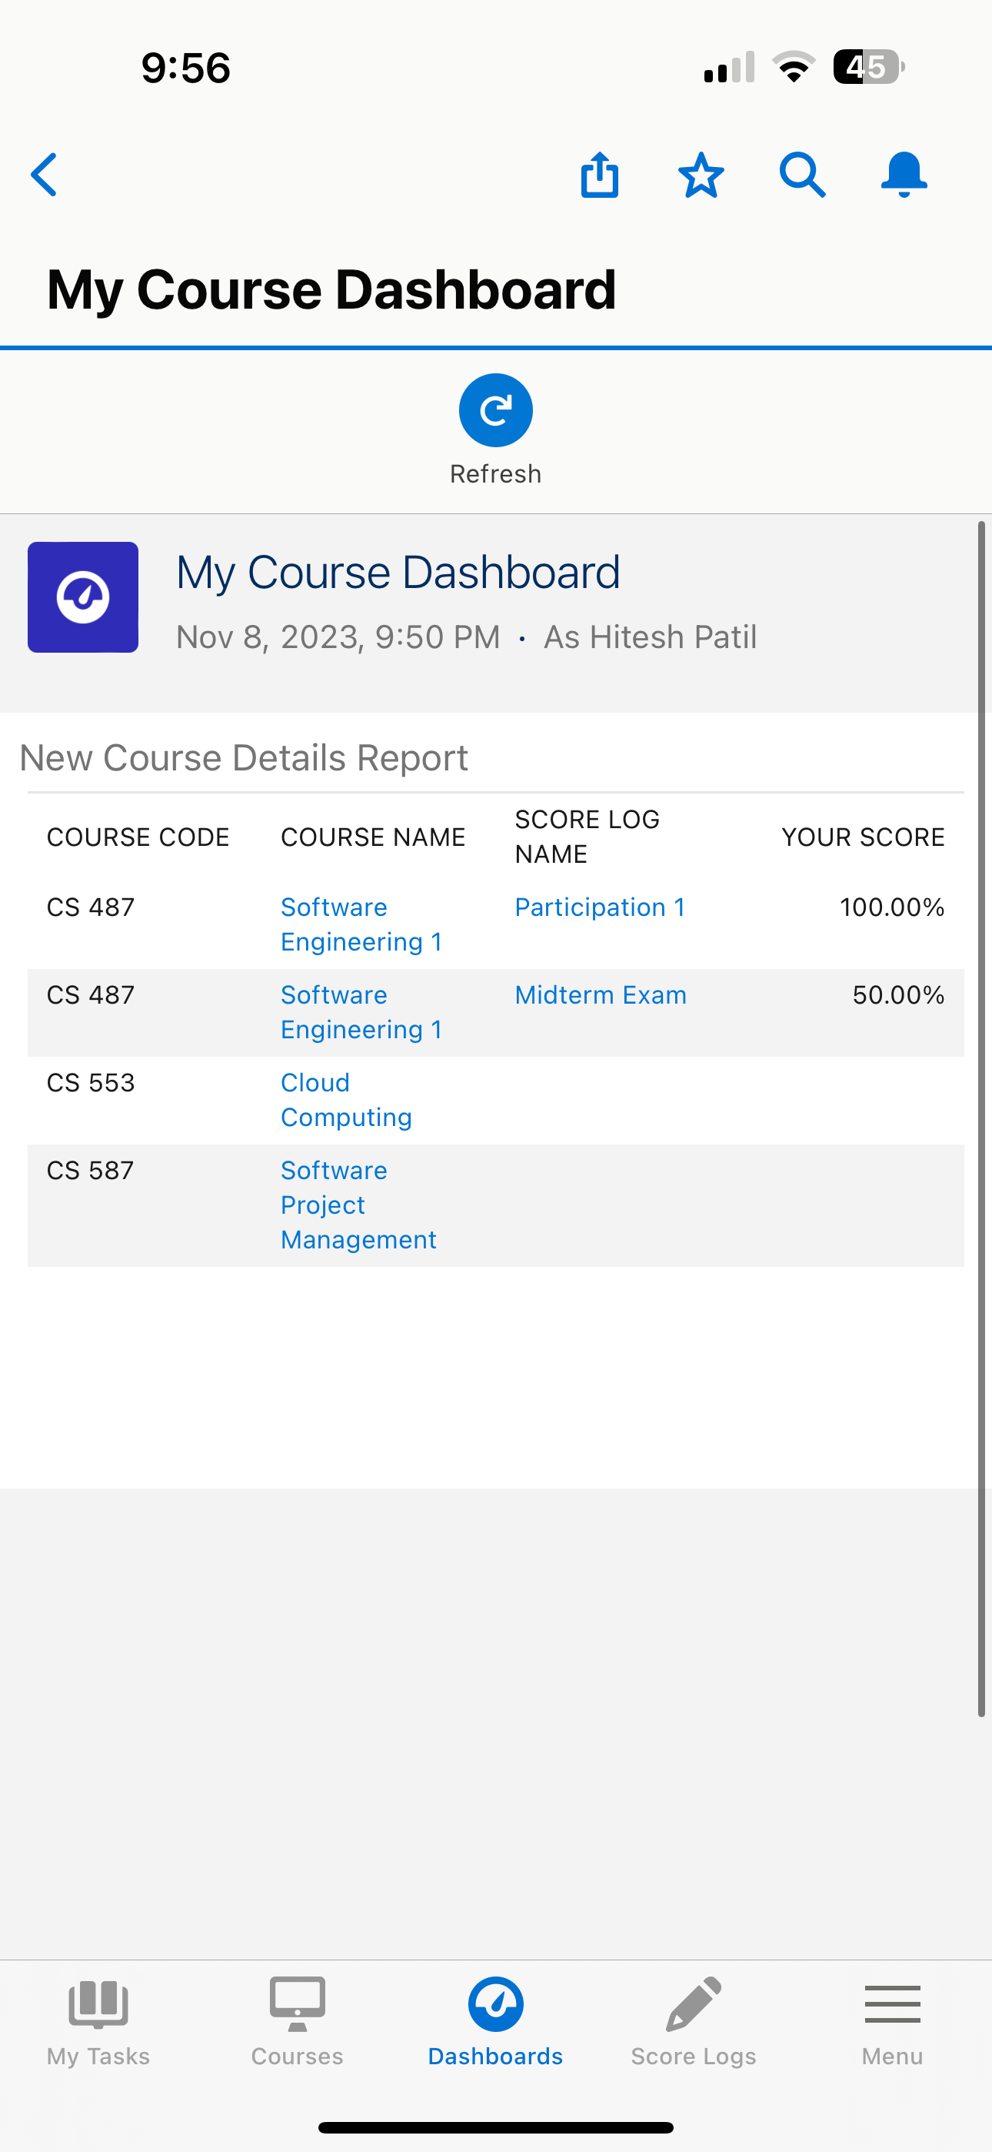
User Interface (Course Management)

Slide 15
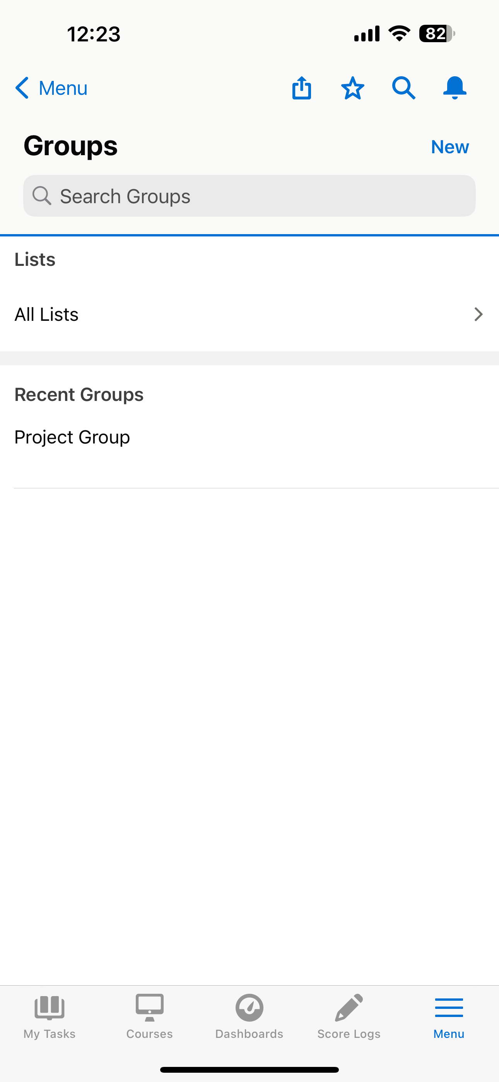
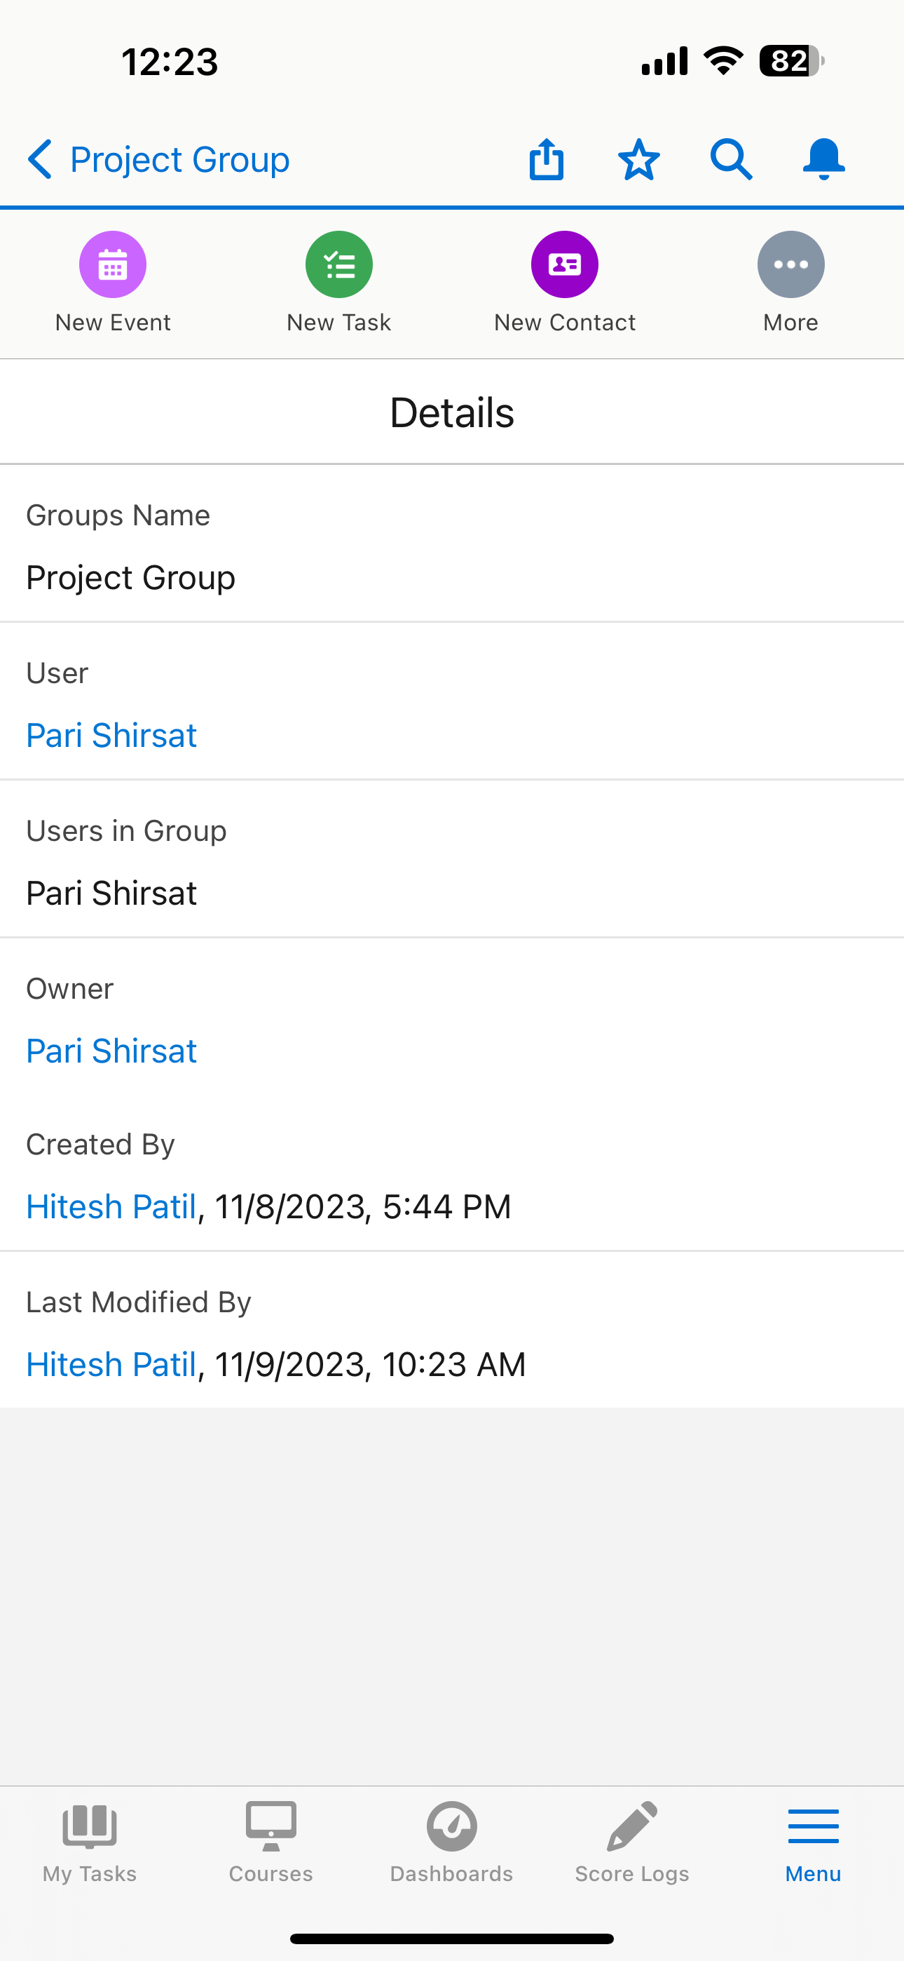
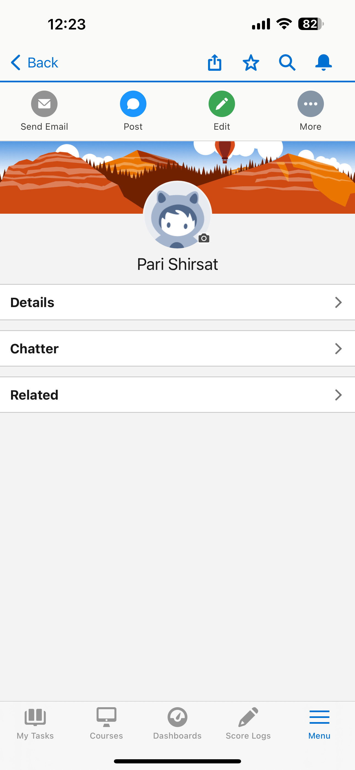
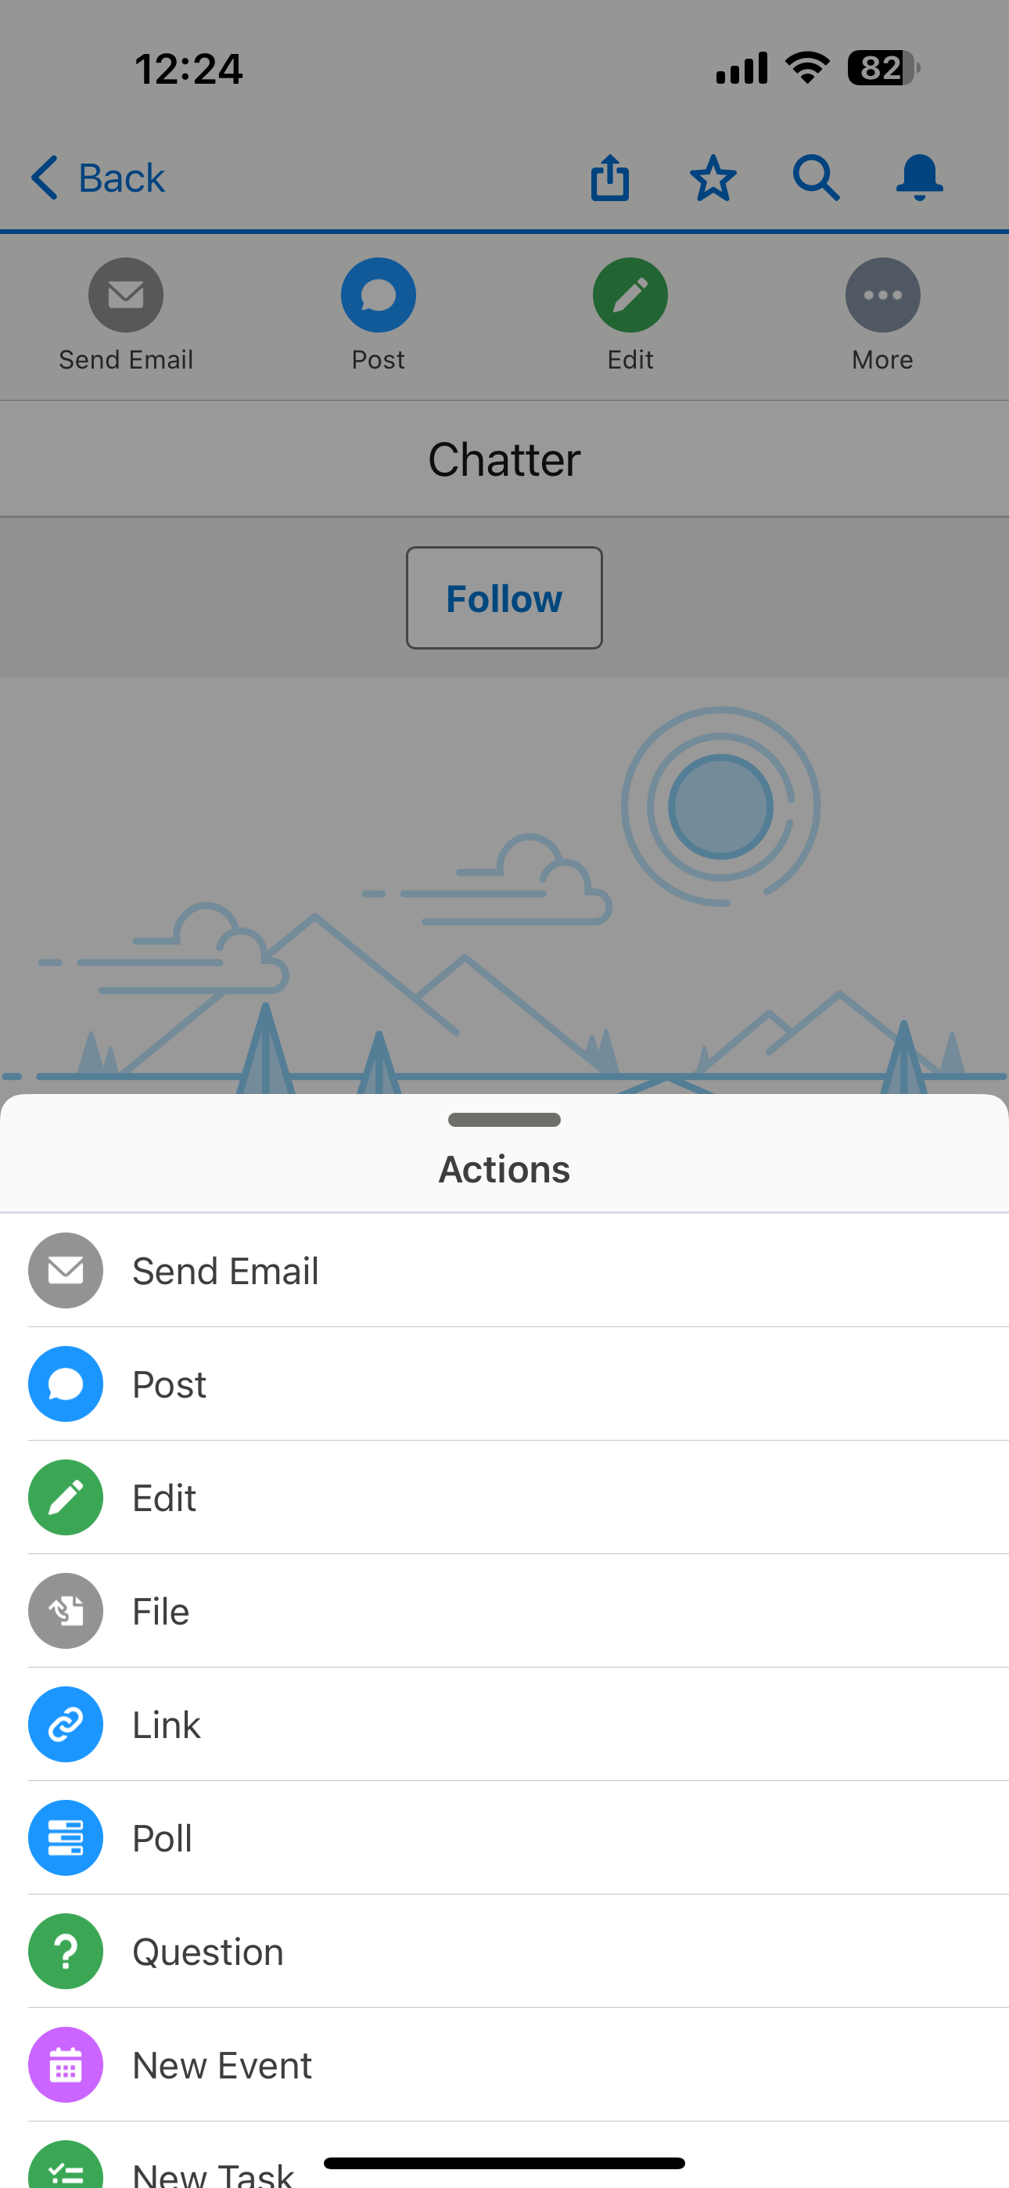
User Interface(User Collaboration)
Public Groups
Project Group and users in it
Other user
Communication channels

Slide 16
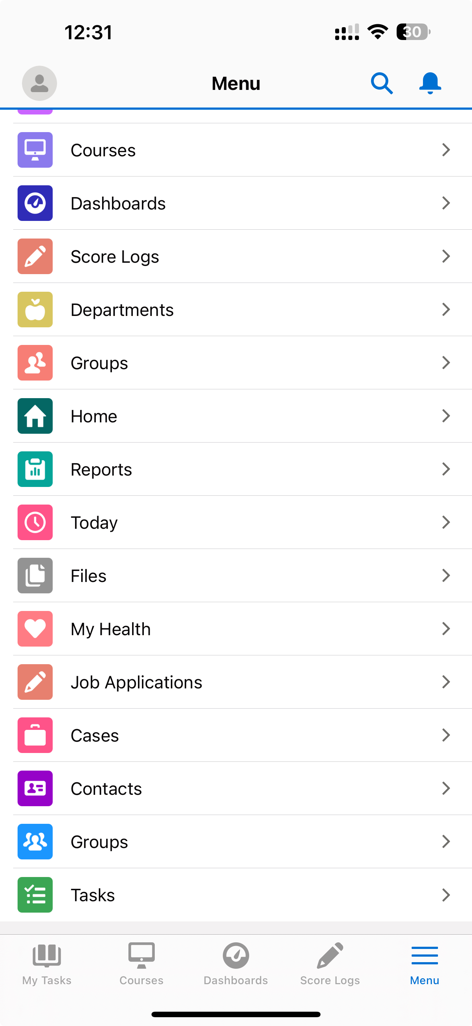
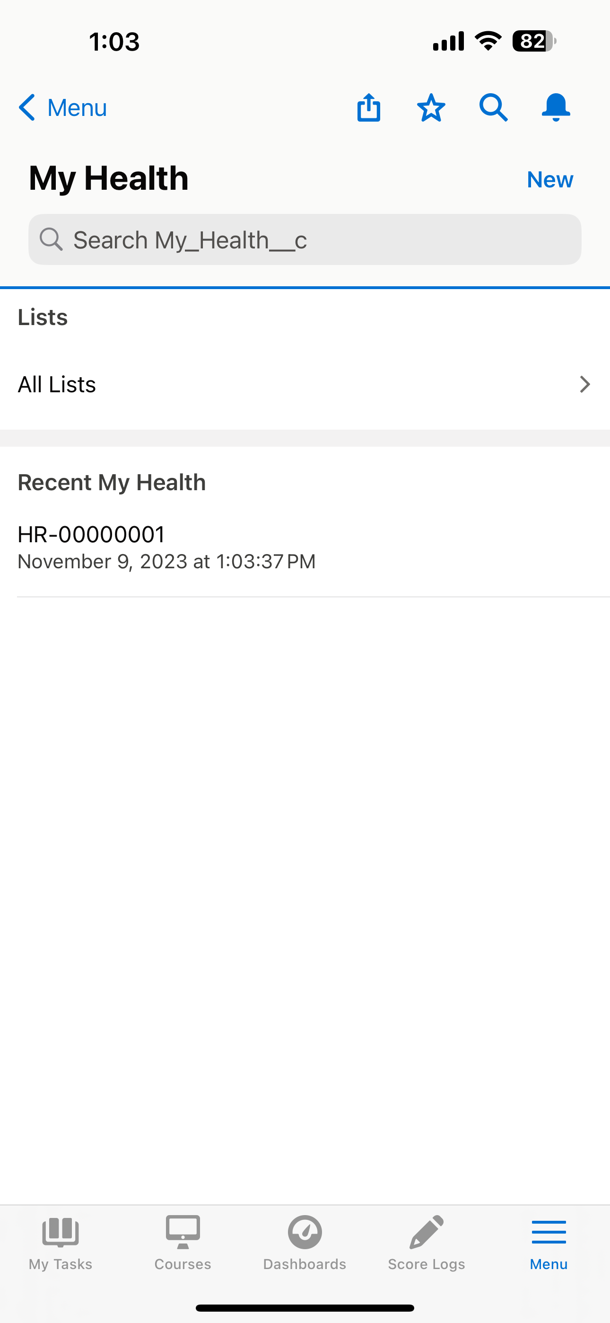
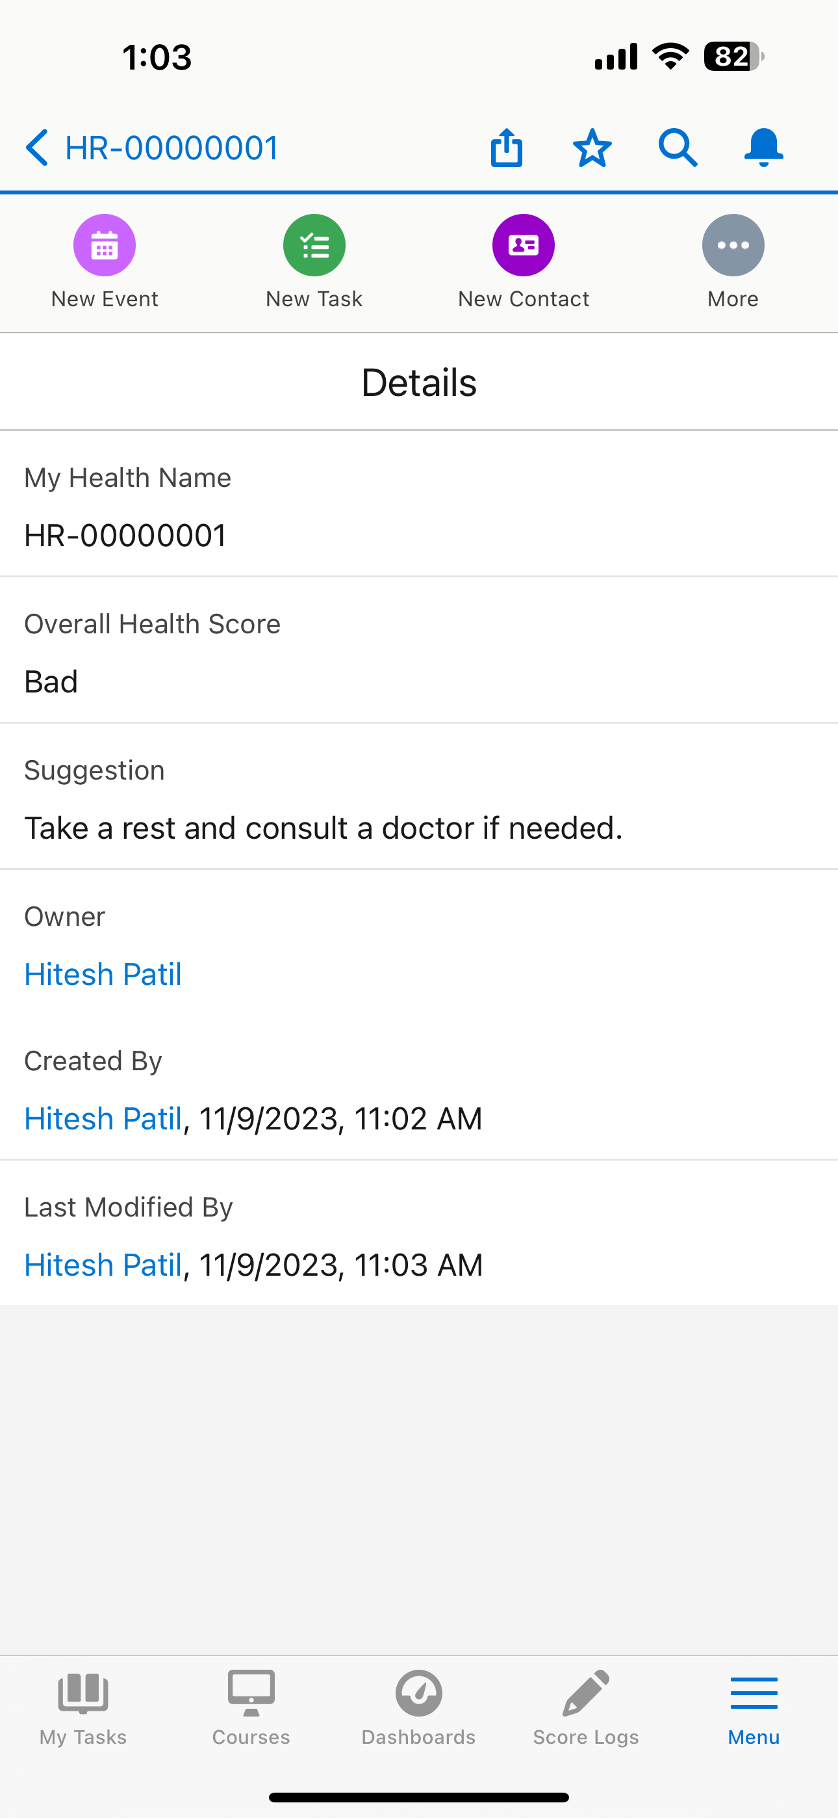
User Interface(Health Management)
Main Menu
My Health Record List
My Health Log

Slide 17
Pseudocode
public class MyTasksController {
// Method to create a new My Task
public static void createMyTask(String taskName, String priority, String relatedCourse, Date dueDate, String owner) {
My_Task__c newTask = new My_Task__c(); newTask.My_Task_Name__c = taskName; newTask.Priority__c = priority; newTask.Related_Course__c = relatedCourse; newTask.Due_Date__c = dueDate;
newTask.Status__c = 'Not started'; // Default status newTask.Owner__c = owner; insert newTask;
}
// Method to update the status of a My Task public static void updateTaskStatus(String taskId, String newStatus) {
My_Task__c task = [SELECT Id, Status__c FROM My_Task__c WHERE Id = :taskId LIMIT 1];
// Check if the task is not already completed if (task.Status__c != 'Completed') {
task.Status__c = newStatus;
// If the new status is "Completed", lock the task if (newStatus == 'Completed') {
task.Locked__c = true; }
update task; }else{
// Task is already completed, handle accordingly (e.g., throw an exception or log a message)
} }
}
public class CourseController {
// Method to create a new Course record public static void createCourse(String courseCode, String courseName, String section) {
Course__c newCourse = new Course__c(); newCourse.Course_Code__c = courseCode; newCourse.Course_Name__c = courseName; newCourse.Section__c = section;
insert newCourse; }
// Method to create a new Score Log record for a specific Course
public static void createScoreLog(String scoreLogName, String courseName, Decimal totalMarks, Decimal obtainedMarks) {
// Query the Course record based on the Course Name
Course__c course = [SELECT Id FROM Course__c WHERE Course_Name__c = :courseName LIMIT 1];
// Create a new Score Log record Score_Log__c newScoreLog = new Score_Log__c(); newScoreLog.Score_Log_Name__c = scoreLogName; newScoreLog.Course__c = course.Id; newScoreLog.Total_Marks__c = totalMarks; newScoreLog.Obtained_Marks__c = obtainedMarks;
// Calculate and set the Your_Score__c field (percentage) if (totalMarks != 0) {
newScoreLog.Your_Score__c = (obtainedMarks / totalMarks) * 100; }
insert newScoreLog; }
}
Course Management Functionality
Task Management Functionality

Slide 18
Pseudocode
public class HealthDataProcessor {
// Salesforce REST API endpoint for receiving health data and sending recommendations
public static String REST_ENDPOINT = 'https://your-salesforce- instance/services/apexrest/healthdata';
// Method to process health data and send recommendations public static void processHealthData(String studentId, Double heartRate) {
// Implement logic to analyze health data and generate recommendations String recommendation = generateRecommendation(heartRate);
// Send recommendation to Salesforce using REST API
sendRecommendationToSalesforce(studentId, recommendation); }
public static String generateRecommendation(Double heartRate) { // Implement logic to analyze heart rate and generate a recommendation // For example, recommend rest if heart rate is too high if (heartRate > 100) {
return 'Take a rest and consult a doctor if needed.'; }else{
return 'Your health is good. Keep it up!'; }
}
public static void sendRecommendationToSalesforce(String studentId, String recommendation) {
// Implement logic to send recommendation to Salesforce using REST API HLpRequest request = new HLpRequest(); request.setEndpoint(REST_ENDPOINT); request.setMethod('POST');
request.setHeader('Content-Type', 'applica7on/json');
request.setBody('{"studentId": "' + studentId + '", "recommendation": "' + recommendation + '"}');
Http http = new Http(); HLpResponse response = hLp.send(request);
//Handletheresponseasneeded }}
public class ReportController {
// Method to generate and display the report public static void generateScoreReport() {
// Query the necessary fields from Course and Score Log objects List<Course__c> coursesWithScores = [SELECT Course_Code__c, Course_Name__c,
(SELECT Score_Log_Name__c, Your_Score__c FROM Score_Logs__r) FROM Course__c];
// Iterate through the results and display the report for (Course__c course : coursesWithScores) {
System.debug('Course Code: ' + course.Course_Code__c); System.debug('Course Name: ' + course.Course_Name__c);
// Iterate through Score Logs related to the course for (Score_Log__c scoreLog : course.Score_Logs__r) {
System.debug('Score Log Name: ' + scoreLog.Score_Log_Name__c);
System.debug('Your Score: ' + scoreLog.Your_Score__c); }
System.debug('------------------------');
}
Course Dashboard Functionality
Health Management Functionality

Slide 19
Risk Assessment
In the field of risk assessment, it is crucial to identify potential system failures and vulnerabilities. Here are some key factors to consider:
Data Protection: Losing user data can have severe consequences, including damage to reputation and legal repercussions. To mitigate this risk, implementing a robust backup and recovery strategy is essential.
User Experience: If users find it difficult to understand the system's features, it can lead to dissatisfaction. To mitigate this risk, it's important to continually strive to develop an intuitive and engaging user interface and provide user education.
System Performance: High user traffic can cause performance issues and system crashes. To mitigate this risk, it is necessary to ensure the system's scalability and conduct rigorous performance testing before deployment.
Code Integration: Integrating new code with the existing codebase during feature deployment can present challenges. Conducting thorough testing before production deployment can help identify and address these integration issues.

Slide 20
Future Goals
Developers from third-party platforms can broaden the range of accessible functionalities and services by integrating their apps through our API.
Allow users to share their accomplishments, learning milestones, and updates on social media directly from the application. This feature enhances the application's integration with social media.
To streamline collaboration between teaching assistants and professors, we are integrating a specialized module for teaching assistants. This feature will make the management of course-related tasks more efficient.
Develop a feature allowing users to use key functions without internet access.

Slide 21
Testing
Ensuring the reliability and performance of an application is crucial, and testing plays a vital role in achieving this goal. Maintaining security requires a continuous and comprehensive process of identifying and addressing potential vulnerabilities through regular audits. It's essential to conduct rigorous tests to confirm that the system can accommodate high user traffic without compromising performance. User Acceptance Testing (UAT) involves the participation of end-users in the testing process to confirm that the application meets their expectations and needs. Continuous monitoring of the system for performance issues is necessary, and scaling should be implemented as required. It's important to thoroughly test the integration of new code with the existing codebase before deployment.

